Slide 1
SociRank Identifying and Ranking Prevalent News Topics Using Social Media Factors

Slide 2
Abstract
Mass media sources, specifically the news media, have traditionally informed us of daily events. In modern times, social media services such as Twitter provide an enormous amount of user-generated data, which have great potential to contain informative news-related content. For these resources to be useful, we must find a way to filter noise and only capture the content that, based on its similarity to the news media, is considered valuable. However, even after noise is removed, information overload may still exist in the remaining data—hence, it is convenient to prioritize it for consumption. To achieve prioritization, information must be ranked in order of estimated importance considering three factors. First, the temporal prevalence of a particular topic in the news media is a factor of importance, and can be considered the media focus (MF) of a topic. Second, the temporal prevalence of the topic in social media indicates its user attention (UA). Last, the interaction between the social media users who mention this topic indicates the strength of the community discussing it, and can be regarded as the user interaction (UI) toward the topic. We propose an unsupervised framework—SociRank—which identifies news topics prevalent in both social media and the news media, and then ranks them by relevance using their degrees of MF, UA, and UI. Our experiments show that SociRank improves the quality and variety of automatically identified news topics.

Slide 3
Existing System
Wartena and Brussee [4] implemented a method to detect topics by clustering keywords. Their method entails the clustering of keywords—based on different similarity measures—using the induced k-bisecting clustering algorithm. Although they do not employ the use of graphs, they do observe that a distance measure based on the Jensen–Shannon divergence (or information radius) of probability distributions performs well.
More recently, research has been conducted in identifying topics and events from social media data, taking into account temporal information. Cataldi et al. [7] proposed a topic detection technique that retrieves real-time emerging topics from Twitter. Their methods uses the set of terms from tweets and model their life cycle according to a novel aging theory.
Additionally, they take into account social relationships—more specifically, the authority of the users in the network—to determine the importance of the topics. Zhao et al. [8] carried out similar work by developing a Twitter-LDA model designed to identify topics in tweets. Their work, however, only considers the personal interests of users, and not prevalent topics at a global scale

Slide 4
Disadvantages
There is no Information filtering for social computing.
There is anonymous topic ranking

Slide 5
Proposed System
In the proposed system, the method proposed an unsupervised method— SociRank—which identifies news topics prevalent in both social media and the news media, and then ranks them by taking into account their MF, UA, and UI as relevance factors.
The temporal prevalence of a particular topic in the news media is considered the MF of a topic, which gives us insight into its mass media popularity. The temporal prevalence of the topic in social media, specifically Twitter, indicates user interest, and is considered its UA.
Finally, the interaction between the social media users who mention the topic indicates the strength of the community discussing it, and is considered the UI. To the best of our knowledge, no other work has attempted to employ the use of either the interests of social media users or their social relationships to aid in the ranking of topics

Slide 6
Advantages
There is effective Topic Identification and keyword extraction.
Efficient Outlier Detection

Slide 7
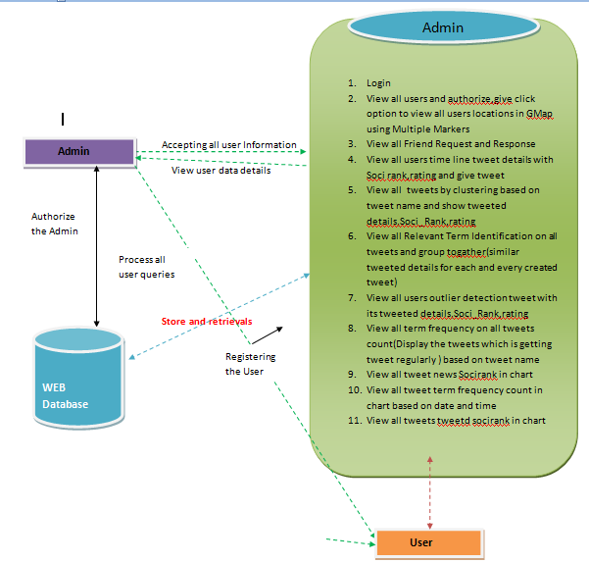
SYSTEM ARCHITECTURE:

Slide 8
SYSTEM REQUIREMENTS
HARDWARE REQUIREMENTS:
System : Pentium Dual Core.
Hard Disk : 140 GB.
Floppy Drive : 1.44 Mb.
Monitor : 15’’ LED.
Mouse : Logitech.
Ram : 1GB.
SOFTWARE REQUIREMENTS:
Operating system : Windows XP/7.
Coding Language : JAVA/J2EE
Data Base : MYSQL

Slide 9
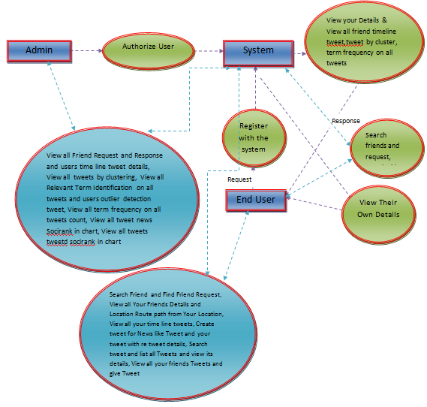
DFD

Slide 10
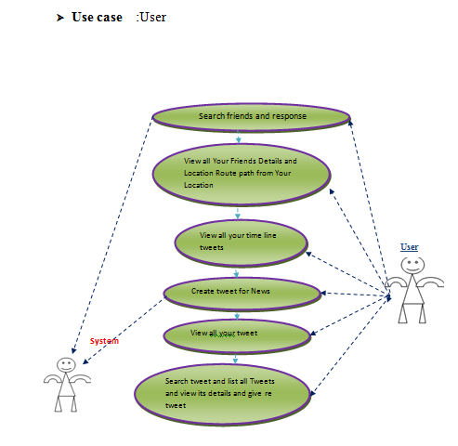
Use Case

Slide 11
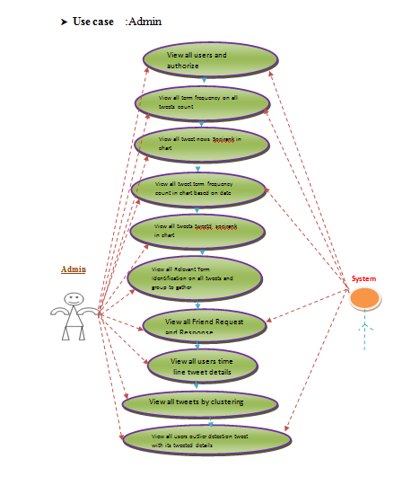
Use Case

Slide 12
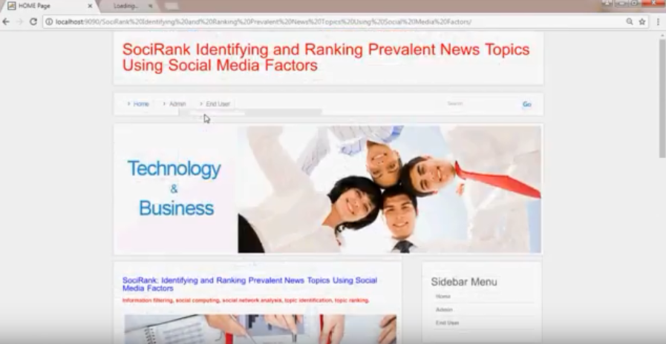
Output Screens

Slide 13
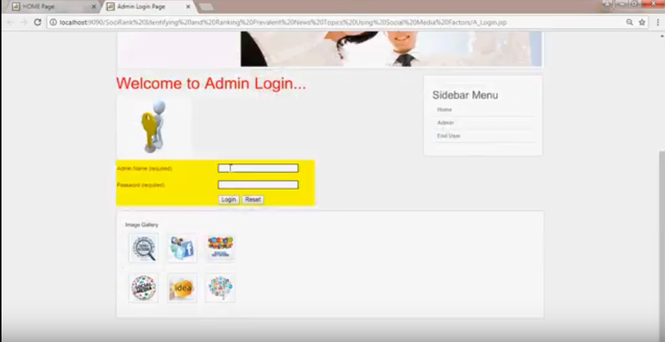
Output Screens

Slide 14
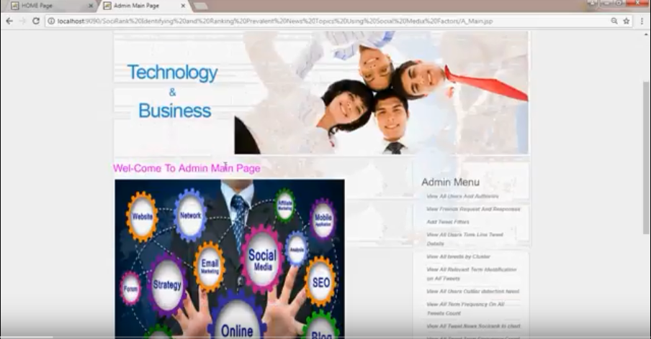
Output Screens

Slide 15
CONCLUSIONS
In this paper, we proposed an unsupervised method— SociRank—which identifies news topics prevalent in both social media and the news media, and then ranks them by taking into account their MF, UA, and UI as relevance factors. The temporal prevalence of a particular topic in the news media is considered the MF of a topic, which gives us insight into its mass media popularity. The temporal prevalence of the topic in social media, specifically Twitter, indicates user interest, and is considered its UA. Finally, the interaction between the social media users who mention the topic indicates the strength of the community discussing it, and is considered the UI. To the best of our knowledge, no other work has attempted to employ the use of either the interests of social media users or their social relationships to aid in the ranking of topics.

Slide 16
Future Work
As future work, we intend to perform experiments and expand SocialRank on different areas and datasets. Furthermore, we plan to include other forms of UA, such as search engine click-through rates, which can also be integrated into our method to provide even more insight into the true interest of users. Additional experiments will also be performed in different stages of the methodology. For example, a fuzzy clustering approach could be employed in order to obtain overlapping TCs (Section III-C). Lastly, we intend to develop a personalized version of SocialRank, where topics are presented differently to each individual user

Slide 17
REFERENCES
[1] D. M. Blei, A. Y. Ng, and M. I. Jordan, “Latent Dirichlet allocation,” J. Mach. Learn. Res., vol. 3, pp. 993–1022, Jan. 2003.
[2] T. Hofmann, “Probabilistic latent semantic analysis,” in Proc. 15th Conf. Uncertainty Artif. Intell., 1999, pp. 289–296.
[3] T. Hofmann, “Probabilistic latent semantic indexing,” in Proc. 22nd Annu. Int. ACM SIGIR Conf. Res. Develop. Inf. Retrieval, Berkeley, CA, USA, 1999, pp. 50–57.
[4] C. Wartena and R. Brussee, “Topic detection by clustering keywords,” in Proc. 19th Int. Workshop Database Expert Syst. Appl. (DEXA), Turin, Italy, 2008, pp. 54–58.
[5] F. Archetti, P. Campanelli, E. Fersini, and E. Messina, “A hierarchical document clustering environment based on the induced bisecting k-means,” in Proc. 7th Int. Conf. Flexible Query Answering Syst., Milan, Italy, 2006, pp. 257–269. [Online]. Available:http://dx.doi.org/10.1007/11766254_22.

